Slide 1
AIRLINE SAFETY
Ruth Maina
DSC640_3.3 Project Task 2
Executive Summary​

Slide 2
AGENDA
Introduction​
Airline accidents
Accidents by model
Airline fatalities
Accident Causes
​Summary​

Slide 3
Business Problem:
Due to recent unfortunate airline crashes, the media has been promoting statistics stating air is no longer a safe way to travel. The news and media outlets have been bombarding the public with reports and figures about the trends of airline safety. What was previously thought as the safest way to travel, especially when compared to automobiles, is now being presented as one of the most dangerous to the public.

Slide 4
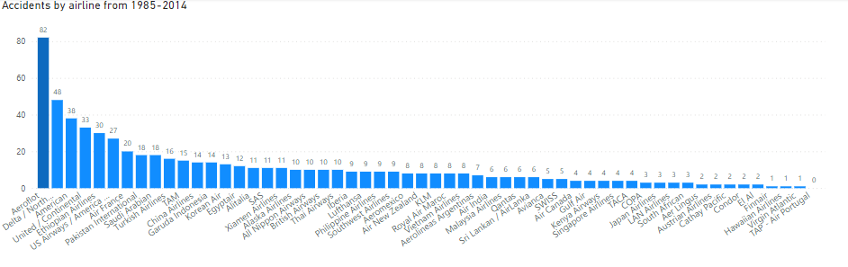

Slide 5
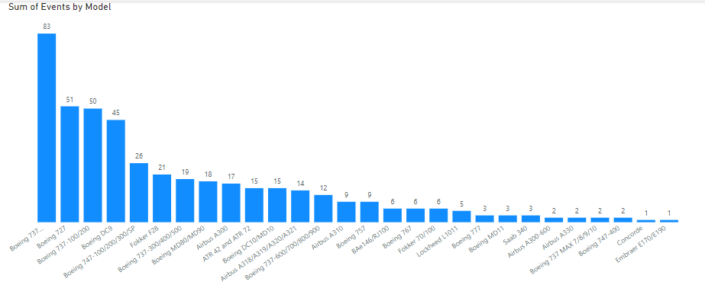

Slide 6
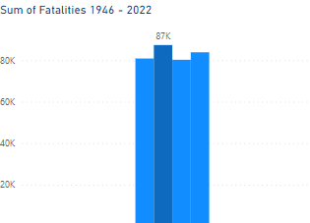

Slide 7
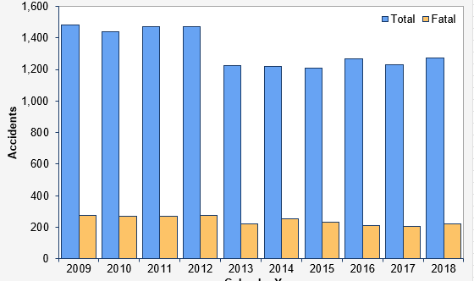

Slide 8
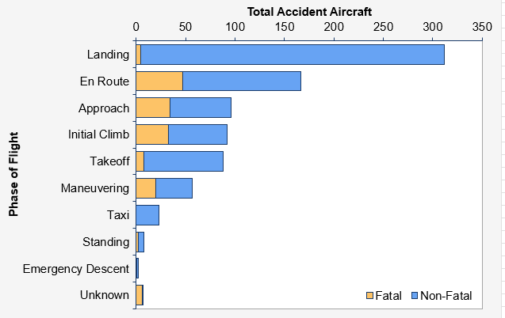

Slide 9
Chart design summary:
Incorporated feedback from milestone 1 and added additional visuals:
Included additional metrics – fatality rate comparison for commercial versus general aviation, added accident causes by phase of flight, added accidents by plane model
Changed Accidents by airline chart type from table to bar graph and sorted from high to low. This tells the story better
Changed fatalities donut chart to bar graph for added data point clarity
Used a deeper shade of blue to call attention to the higher numbers
Eliminated some axis labels and all legends and instead gave descriptive titles for each visual to lessen clutter
Continued to use the blue theme with different shades of the same color to enhance consistency in all the charts since its appealing and has a professional look overall.
Airline data summary:
In examining the Initial Airline Dataset containing Accidents and Fatalities Per Year:
The total count of the highest recorded accidents to be at 4096 from 1946 – 2022.
Thus, in a span of 76 years:
This is approximately 54 accidents per year / ~5 per month
Fatalities in the same timeframe come to about 87,377:
This is approximately 1150 per year / 96 per month / 3 per day
Incidents sorted by airline appear to be occurring the most Aeroflot at 82 accidents followed by Delta at 48 and American at 38
Ethics summary :
Data is reported for a variety of timeframes. Also summed up and reordered some of the columns in the airline-safety excel file and assumed that 85-99 and 00-14 means 1985 – 1999 and 2000 – 2014.

Slide 10
END NOTE:
Motor vehicles data from NHTSA indicates 100 deaths occur per day in 2016 – this does not compare to ~3 deaths for airlines daily average.
This is an indication that airlines are one of the safest methods of transportation.

Slide 11
REFERENCE LINKS
https://www.ntsb.gov/safety/data/Pages/AviationDataStats2018.aspx
https://www.ntsb.gov/safety/data/Pages/Data_Stats.aspx
https://www.airsafe.com/events/models/rate_mod.htm
https://pilotinstitute.com/aviation-accident-causes/
https://www.psbr.law/aviation_accident_statistics.html
https://en.wikipedia.org/wiki/Motor_vehicle_fatality_rate_in_U.S._by_year

